Slide 1

Efficient Business Processes with Process Mining
Ilya Fainberg
Sr. Program Manager
Microsoft

Slide 2




Ilya Fainberg
Started out as a developer about 20 years, incidentally my first commercial project was a custom CRM system.
Worked in different industries but mostly in business automation solutions until finally finding Dynamics CRM 3.0 and later, Power Platform.
Implemented solutions in 40 countries for anything from local companies to global organizations.
I enjoy travelling, flying, gaming, coding and building stuff.
youtube.com/c/IlyaFainberg
Linkedin.com/in/ifainb
@ifainberg

Slide 3
Process mining: What is it for?
Every organization has a set of processes they work by.
KPIs need to be defined to create reporting to understand how these processes work.
Process Mining is the convergence of AI-driven intelligence, business data and modern analytics

Slide 4
What processes work?
Customer Service
Invoice Processing
Efficient Manufacturing
Lead Qualification
Sales Processes

Slide 5







This is something new, right?

Slide 6
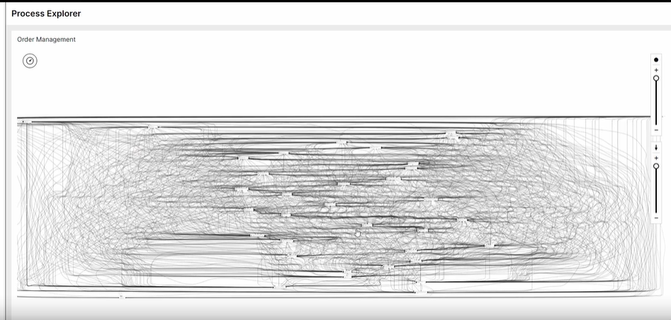
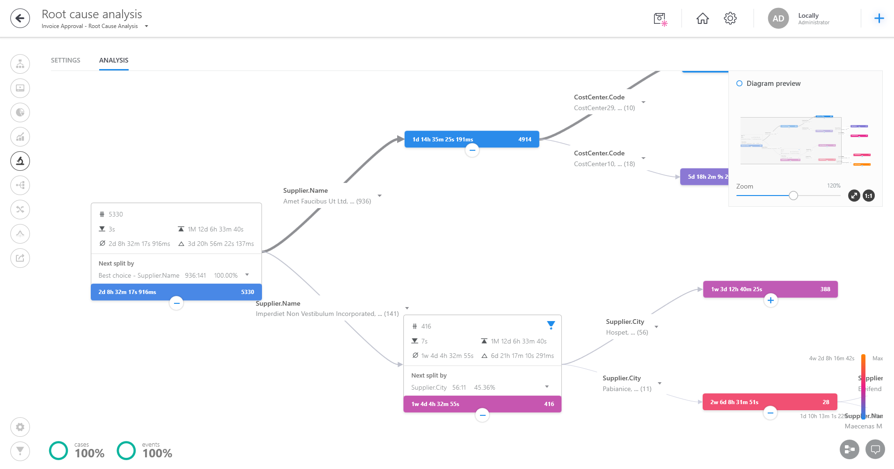
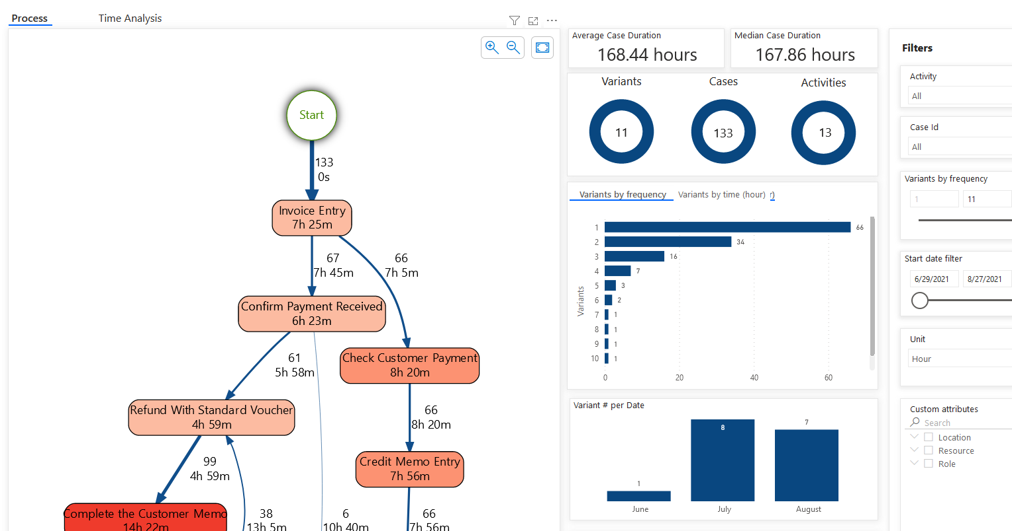
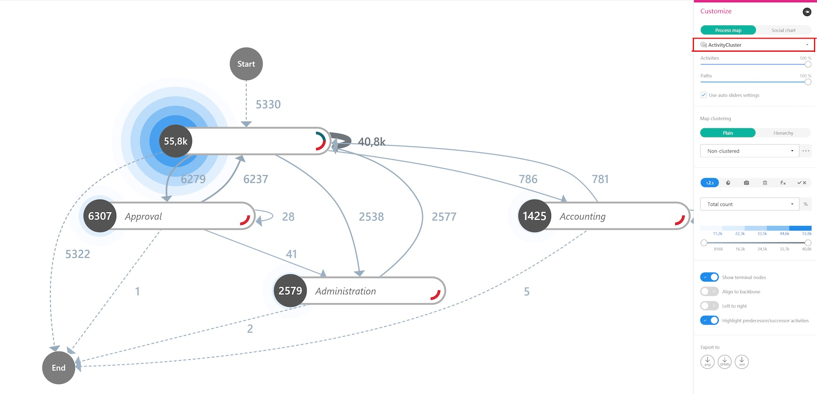
What are we doing differently?
Built for Makers
Notes:
Process Mining is part of Power Automate and the larger Power Platform umbrella.
Building on the citizen developer philosophy, we want to democratize Process Mining, make it available to Pedro from Accounting and Phil from Sales.
Not just for data scientists anymore.
It’s not to say that complex scenarios are not possible, they are and they will need professional help.
Bu the difference is that professionals would be able to work more efficiently and serve a larger pool of customers.

Slide 7
How it works?
Instance
Name
Event
Timestamp
Name of the Process
Id of process execution
When the event happened
Event name
Event Log
Data is analyzed based on events in the source system that are tied to a process instance and an activity.
Must contain start timestamp
Activity Log
Data is analyzed based on activities tied to a process instance and an activity type.
Must contain start and end timestamp
Stored in Dataverse

Slide 8

Demo
Notes:
Process Mining comes to Canvas Apps soon to mine user experience.

Slide 9
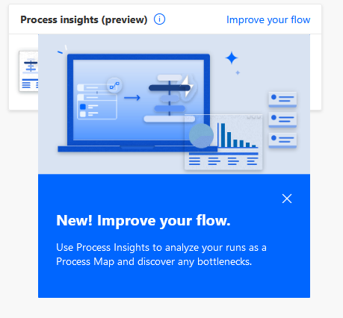
Where are we taking it?
(EVERYWHERE)
Process Mining can already give you insights based on data from a variety of systems
Now you have built-in integration with Power Automate.
In the future expect an even tighter with Power Platform tools.
Notes:
Process Mining comes to Canvas Apps soon to mine user experience.

Slide 10
Process Mining + PowerApps
Instance
Name
Event
Timestamp
Name of the Process App
Id of process execution
When the event happened
App event name
Session Id
Building Power Apps is an investment. In many cases we don’t know if it paid off.
Understanding app usage patterns can be easy and accessible to both developers and business users.
All we need to do is to think of an app as if it were a process, to then leverage Process Mining:
https://www.youtube.com/watch?v=794sFs-sWF8
Get THE TRACER: https://github.com/Feincraft/TheTracer
Notes:
Process Mining comes to Canvas Apps soon to mine user experience.

Slide 11
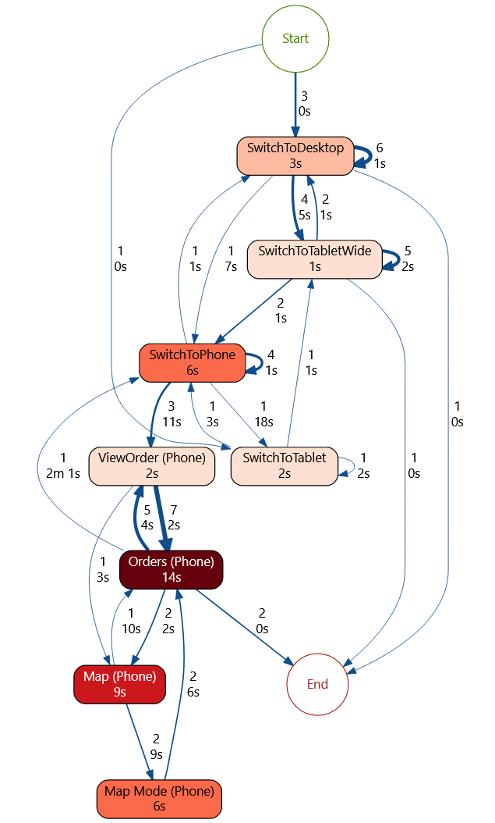
Notes:
Process Mining comes to Canvas Apps soon to mine user experience.

Slide 12
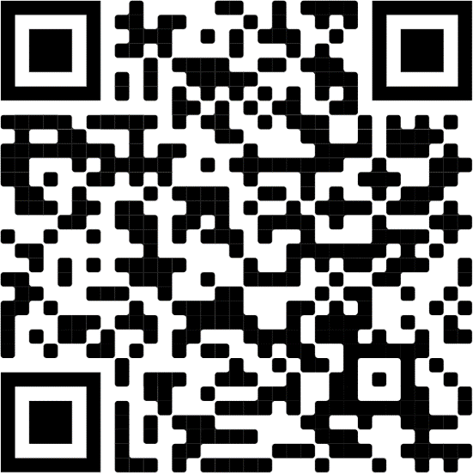

linkedin.com/company/fasttrackdynamics365/

Slide 13


https://linktr.ee/feincraft

Slide 14
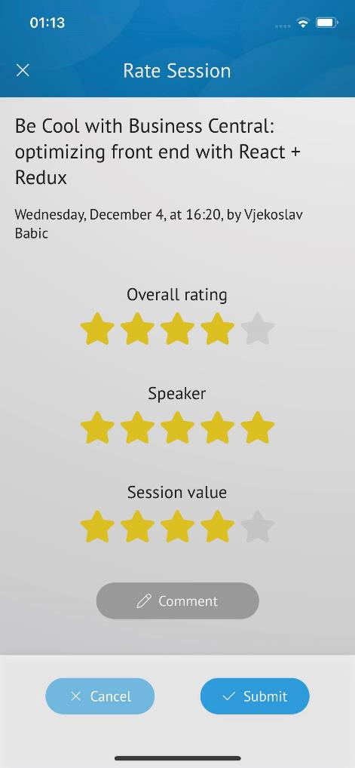


Give us Feedback !
Hope you enjoyed this session!
Please help us improve and give session feedback in the App!
Thank you !

